Slide 1
Orange High School
Visual Arts Department
presents

Slide 2
Essex County
Teen Arts
Festival Entries
The following work was curated by the
visual arts teachers and
was submitted for adjudication.

Slide 3
Two Orange High School students
were selected to have their art appear
at the state level.
Congratulations to
Brenda Palencia and Oluchi Ugbuaja

Slide 4
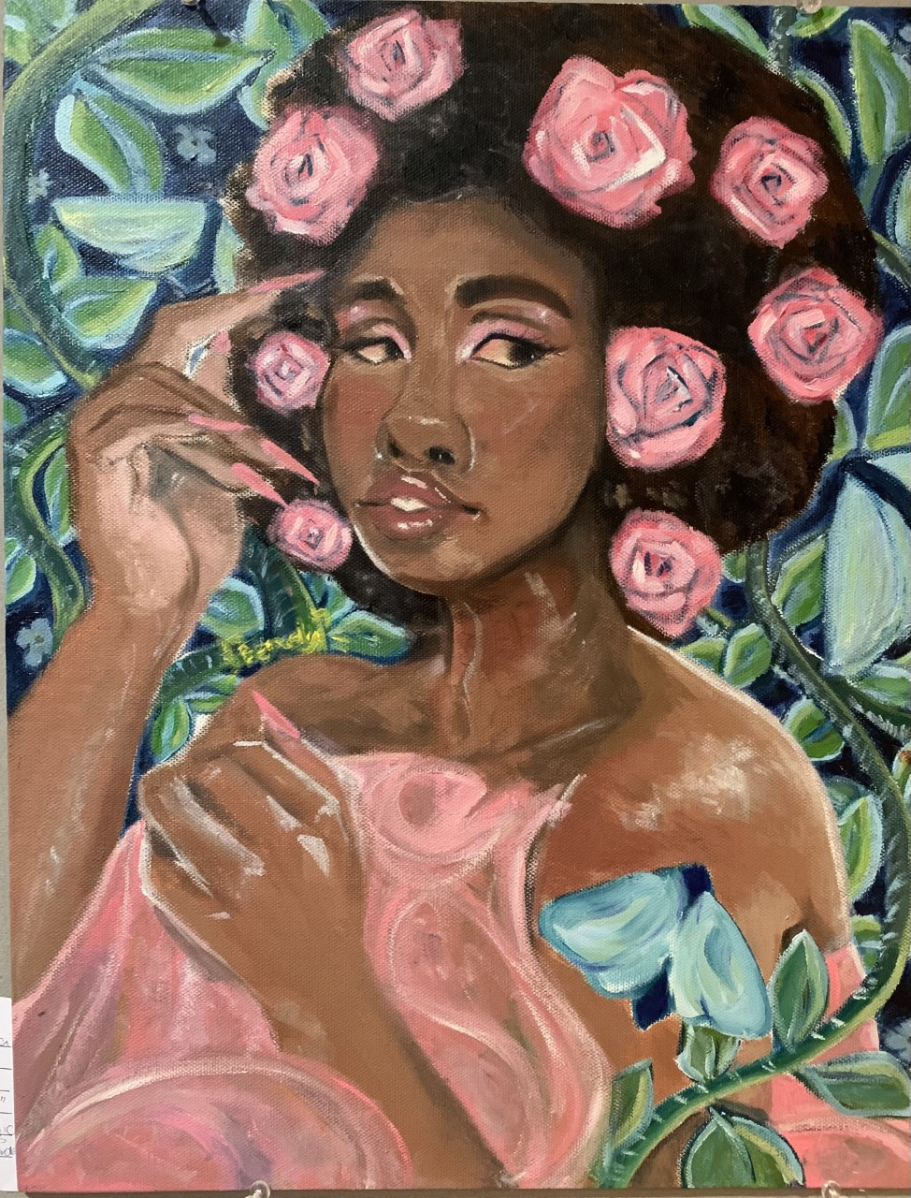
Brenda

Slide 5
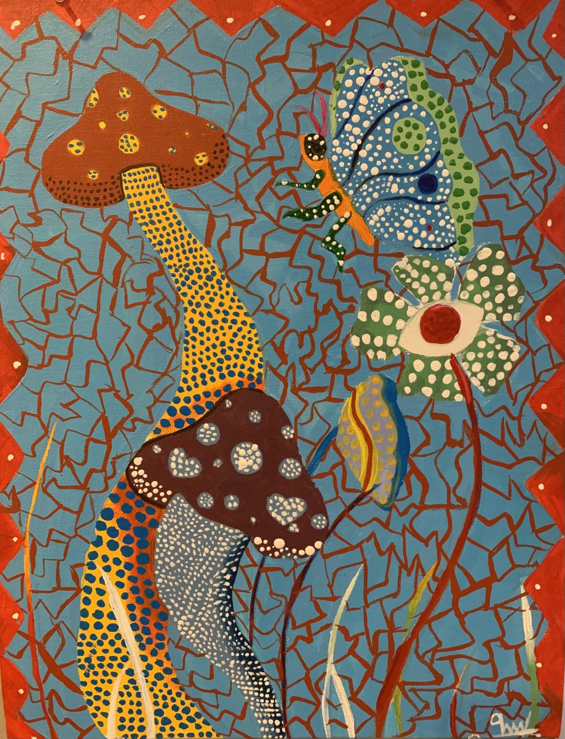
Oluchi

Slide 6
Essex County
Teen Arts
Festival Entries
Your teachers are proud of all the
hard work and growth you have shown this year.
Thank you for representing Orange High School.

Slide 7
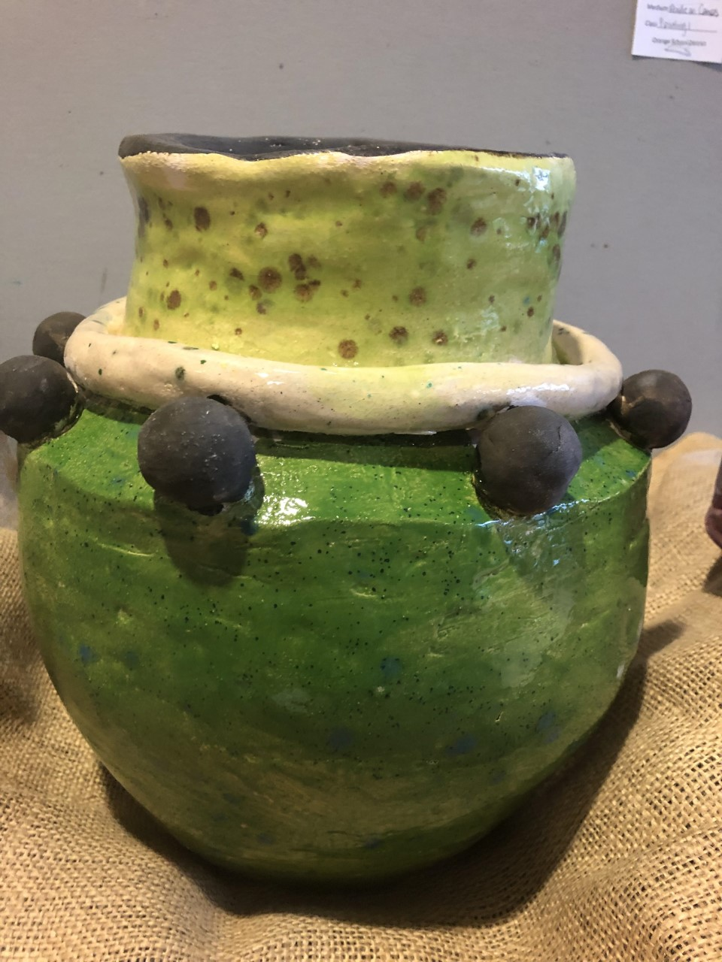
Anthony

Slide 8
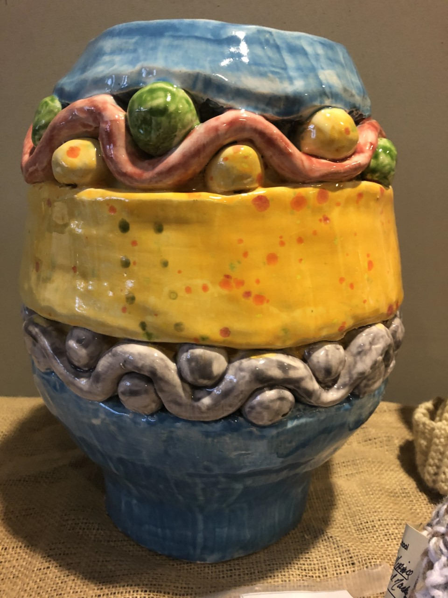
Bryan

Slide 9
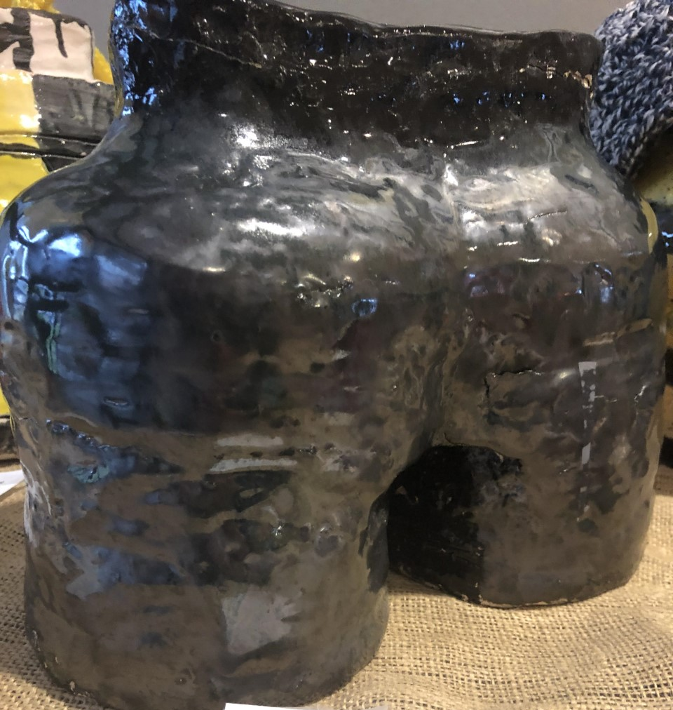
Dana

Slide 10
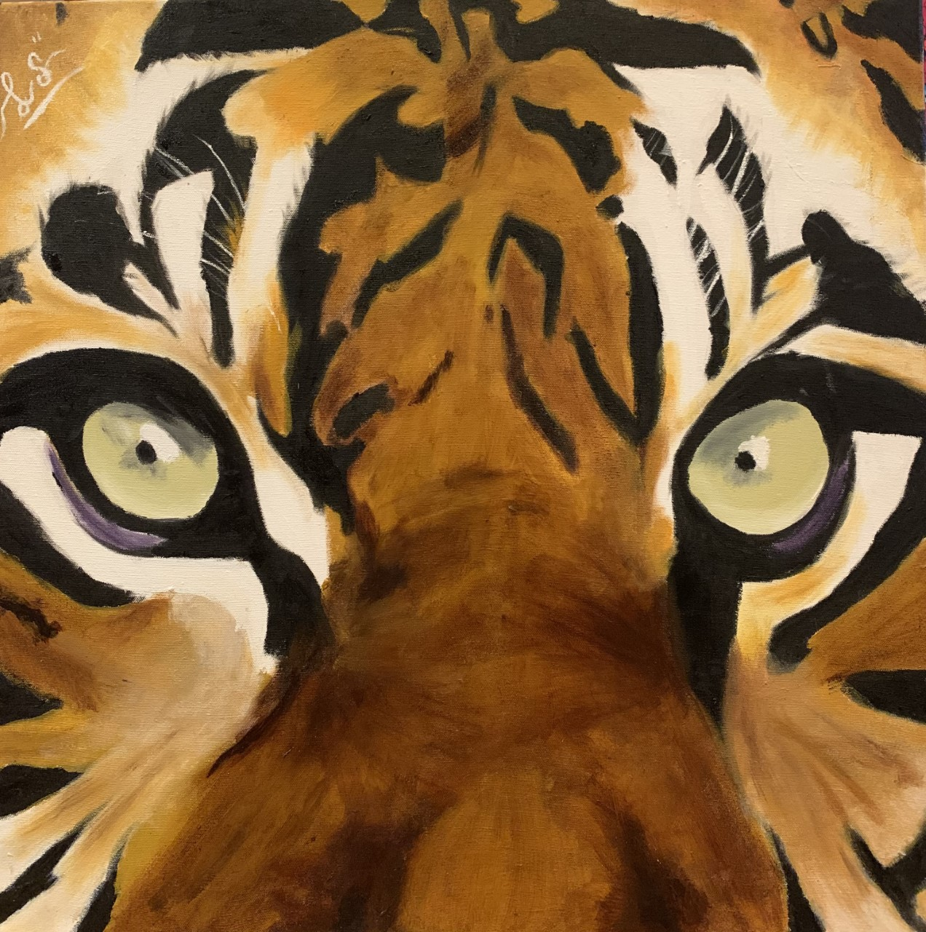
Danny

Slide 11
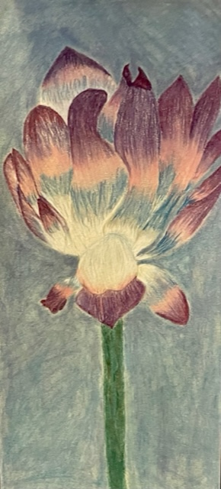
Fineshara

Slide 12
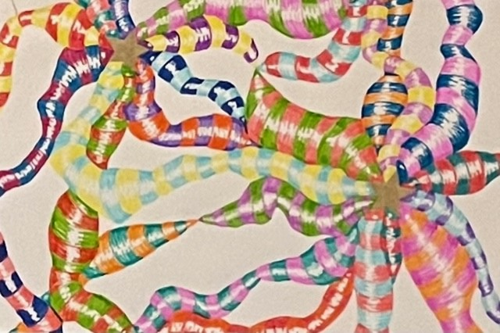
Jalean

Slide 13
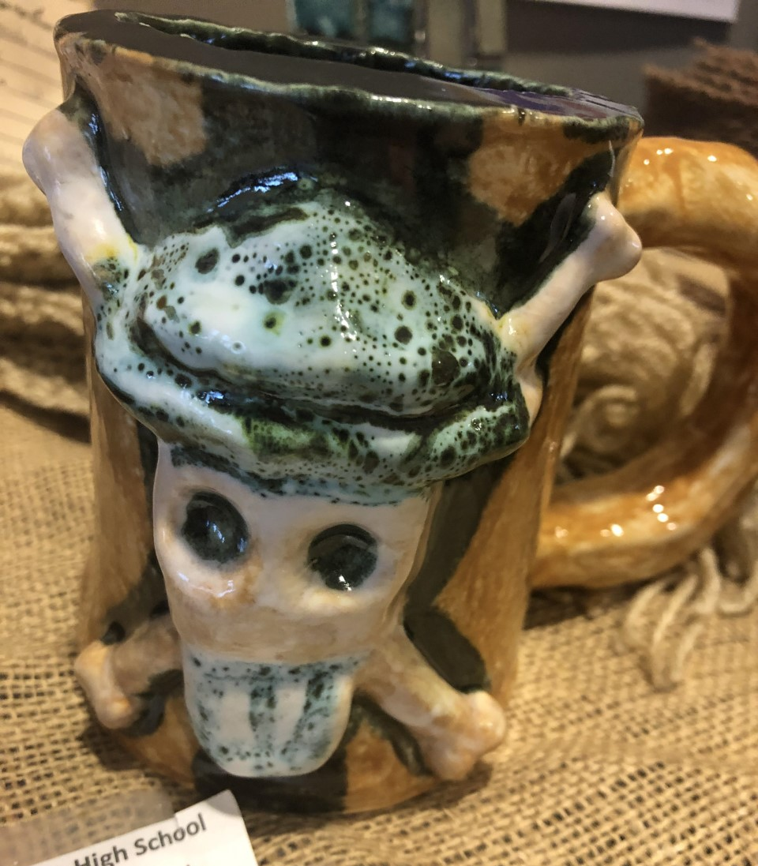
Kelon

Slide 14
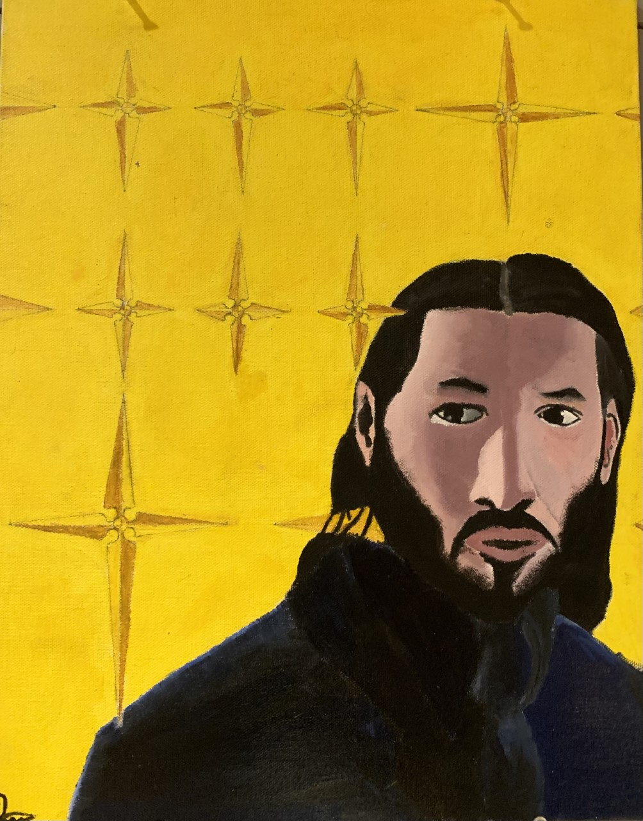
Krishna

Slide 15
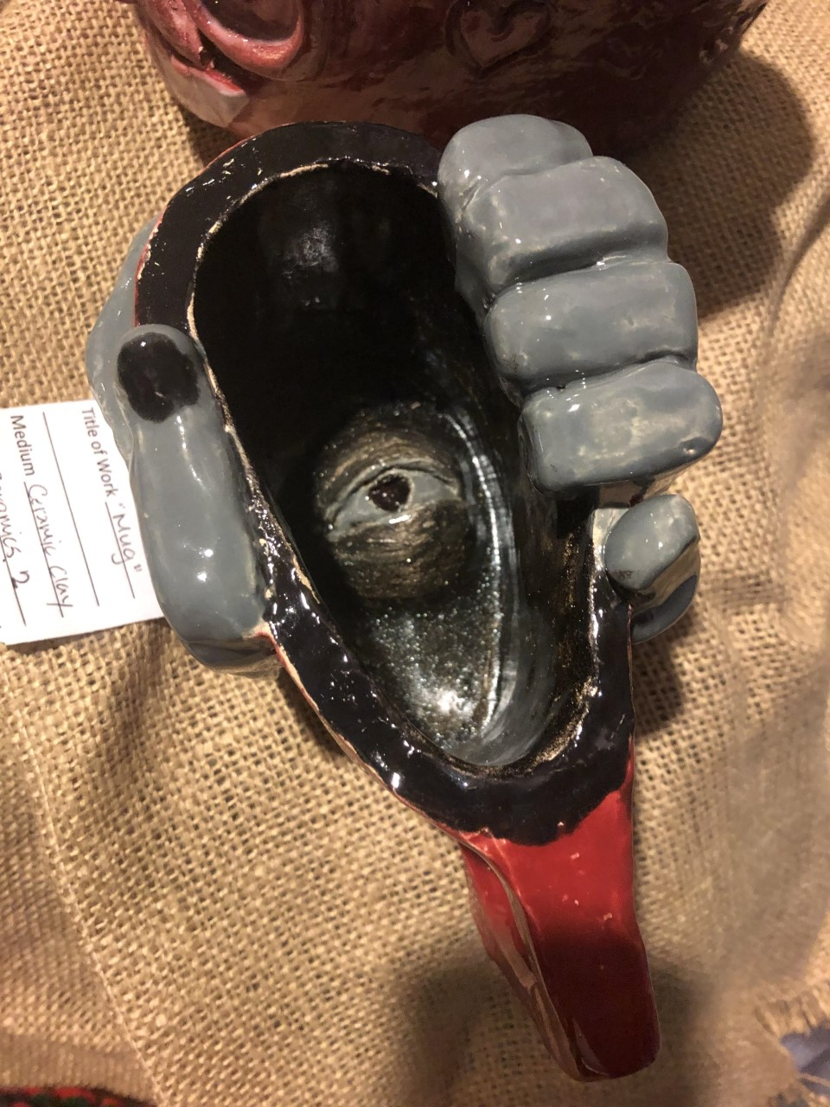
Lanique

Slide 16
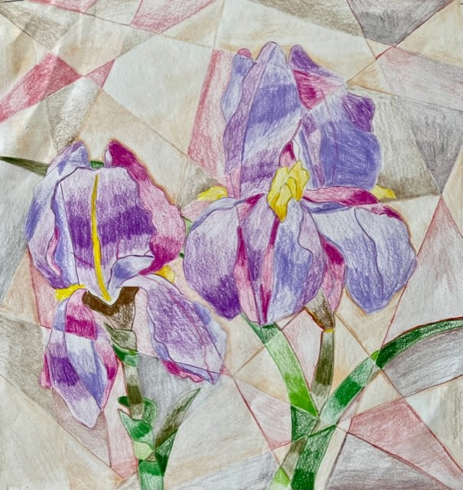
Makayla

Slide 17
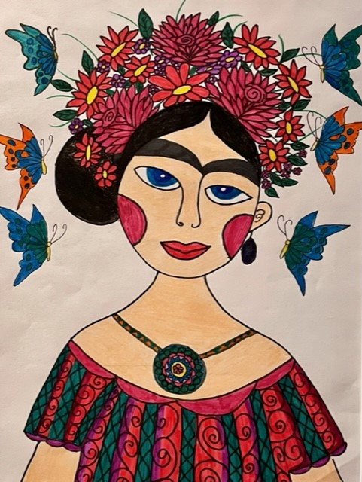
Marjuri

Slide 18
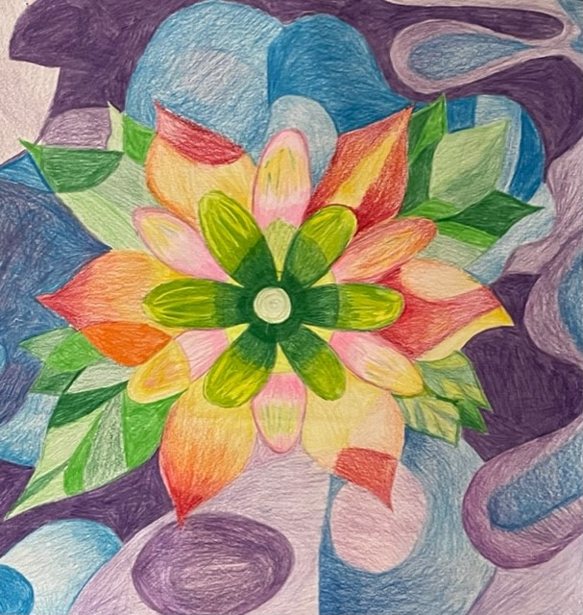
Nallyly

Slide 19
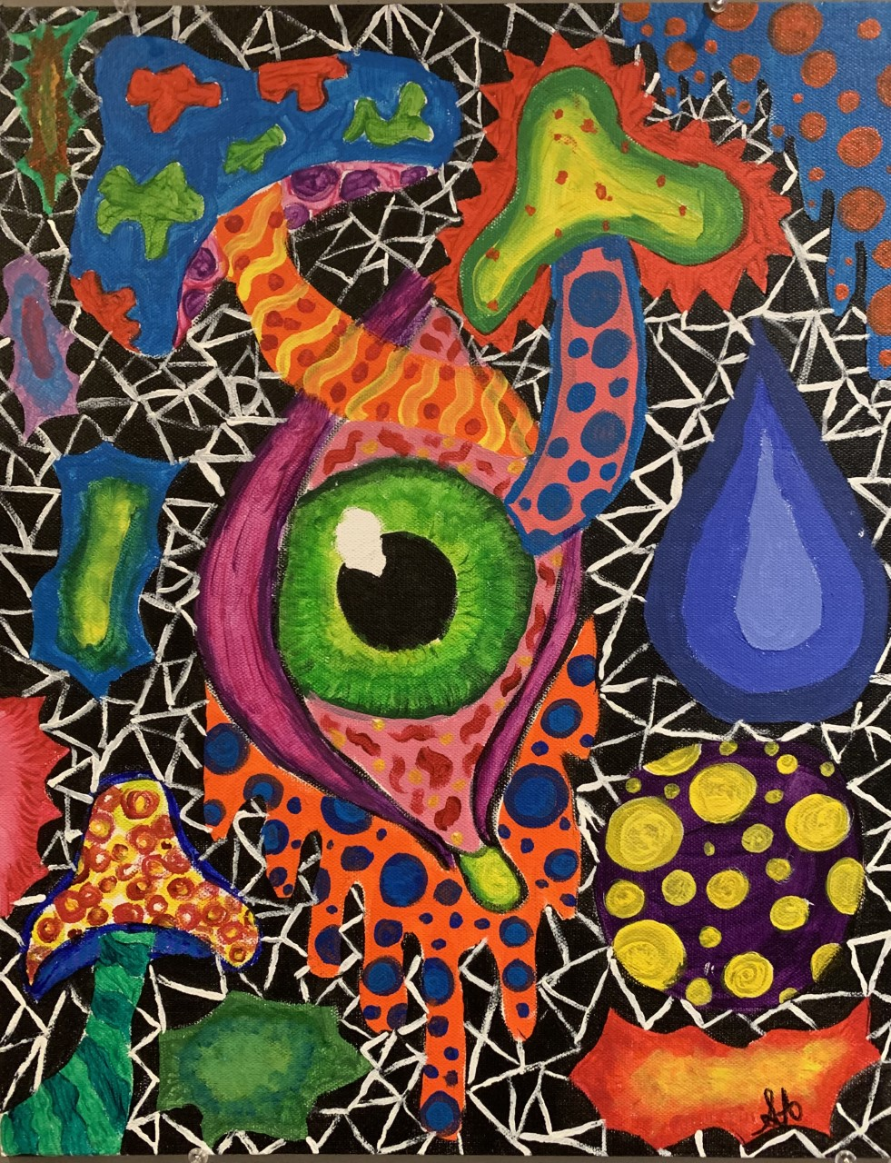
Sofia

Slide 20
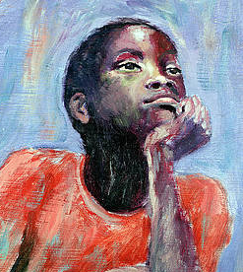
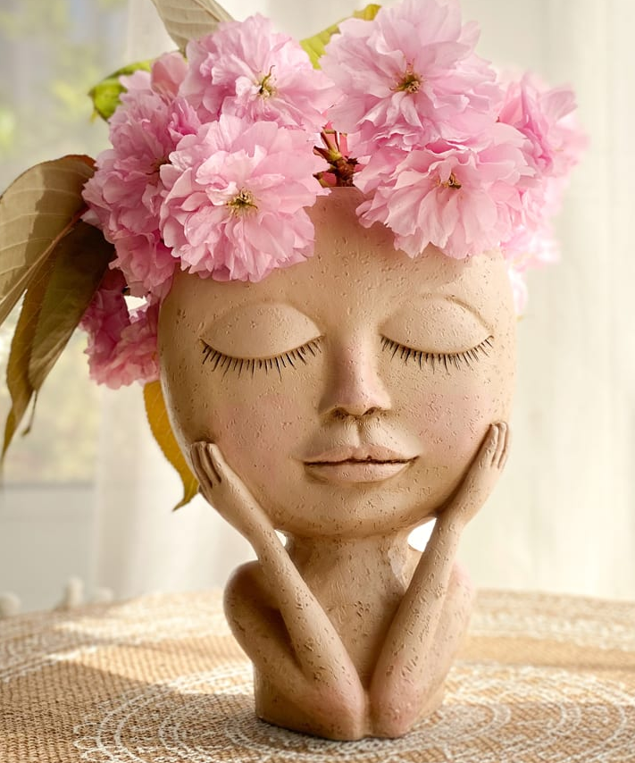
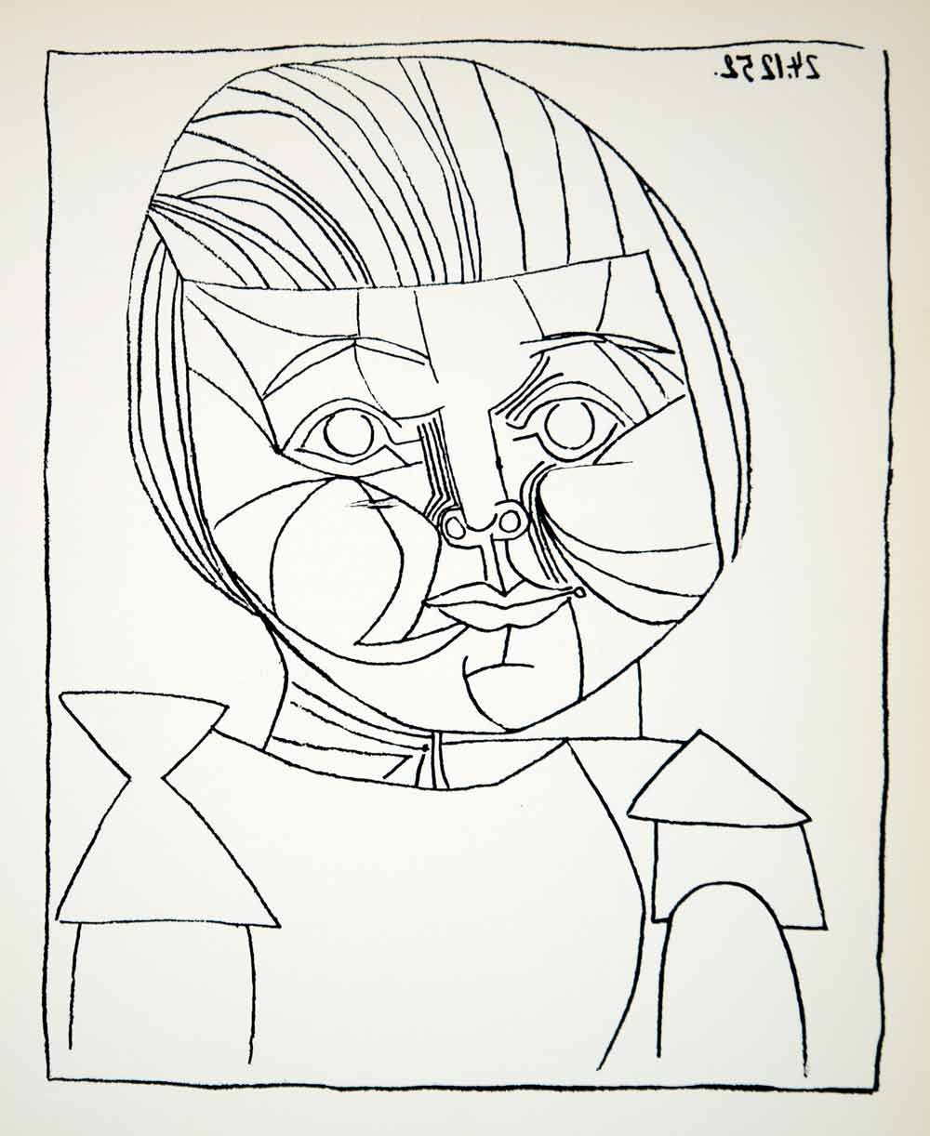
OHS Visual Arts Team
Shana Falda
Nate Brown
Megan Guerriero
Monique Fineman
Represented as children in art.
Artists: Carlton Murrell, Camille Pissarro,
Unknown sculptor, Pablo Picasso

Slide 21
A Special Thanks!
to
Dr. Donna Sinisgalli
Director of Visual and Performing Arts
Dr. Sinisgalli is retiring this year from Orange and we would like to thank her for her years of support of
the arts and education at Orange Public Schools.

